Slide 1
Visualizing Software Architectures, Part 2
Software Architecture
Lecture 12

Slide 2
Objectives
Concepts
  What is visualization?
  Differences between modeling and visualization
  What kinds of visualizations do we use?
  Visualizations and views
  How can we characterize and evaluate visualizations?
Examples
  Concrete examples of a diverse array of visualizations
Constructing visualizations
  Guidelines for constructing new visualizations
  Pitfalls to avoid when constructing new visualizations
  Coordinating visualizations

Slide 3
UML Visualizations
Canonical graphical depictions + tool-specific interactions
XMI: Textual depiction in XML + text-editor interactions
Advantages
  Canonical graphical depiction common across tools
  Graphical visualizations have similar UI metaphors to PowerPoint-style editors, but with UML semantics
  XMI projection provides textual alternative
Disadvantages
  No standard for interaction as there is for depiction
  In some tools hard to tell where UML model ends and auxiliary models begin
  Most UML visualizations are restricted to (slight variants) of the canonical UML depiction

Slide 4
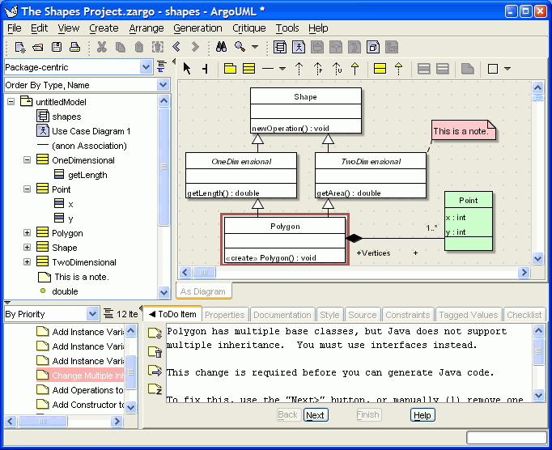
UML Visualization
Software Architecture: Foundations, Theory, and Practice; Richard N. Taylor, Nenad Medvidovic, and Eric M. Dashofy; (C) 2008 John Wiley & Sons, Inc. Reprinted with permission.

Slide 5
UML Visualization
<UML:Class xmi.id = '723'
name = 'Data Store'
visibility = 'public'
isSpecification = 'false'
isRoot = 'false'
isLeaf = 'false'
isAbstract = 'false'
isActive = 'false'/>
<UML:Association xmi.id = '725'
name = ''
isSpecification = 'false'
isRoot = 'false'
isLeaf = 'false'
isAbstract = 'false'>
<UML:Association.connection>
<UML:AssociationEnd xmi.id = '726'
visibility = 'public'
isSpecification = 'false'
isNavigable = 'true'
ordering = 'unordered'
aggregation = 'none'
targetScope = 'instance'
changeability = 'changeable'>
<UML:AssociationEnd.multiplicity>
<UML:Multiplicity xmi.id = '727'>
<UML:Multiplicity.range>
<UML:MultiplicityRange xmi.id = '728'
lower = '1'
upper = '1'/>
...
Software Architecture: Foundations, Theory, and Practice; Richard N. Taylor, Nenad Medvidovic, and Eric M. Dashofy; (C) 2008 John Wiley & Sons, Inc. Reprinted with permission.

Slide 6
UML Visualizations: Evaluation
Scope/Purpose
  Visualization of UML models
Basic Type
  Graphical (diagrams), textual (XMI)
Depiction
  Diagrams in UML symbolic vocabulary/XML-formatted text
Interaction
  Depends on the editor; generally point-and-click for diagrams; text editor for XMI
Fidelity
  Diagrams are canonical, XMI elides layout info
Consistency
  Generally good across diagrams; small exceptions
Comprehensibility
  Ubiquity assists interpretations
Dynamism
  Rare
View coordination
  Some editors better than others
Aesthetics
  Simple symbols reduce complexity; uniform diagrams
Extensibility
  Profile support OK; major language extensions hard

Slide 7
Rapidé
Rapidé models are generally written with a canonical textual visualization
  Some graphical builders available as well
Focus: Interesting effect visualization of simulation results
Advantages
  Provides an intuitive way to visualize the causal relationships between events
  Automatically generated from Rapide specifications
Disadvantages
  Complex applications generate complex graphs
  Difficult to identify why particular causal relationships exist
    Simulation is not interactive

Slide 8
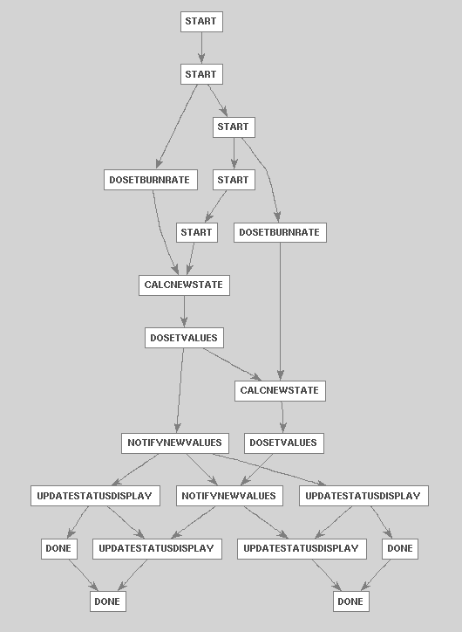
Rapidé Examples
type DataStore is interface
action in SetValues();
out NotifyNewValues();
behavior
begin
SetValues => NotifyNewValues();;
end DataStore;
type Calculation is interface
action in SetBurnRate();
out DoSetValues();
behavior
action CalcNewState();
begin
SetBurnRate => CalcNewState(); DoSetValues();;
end Calculation;
type Player is interface
action out DoSetBurnRate();
in NotifyNewValues();
behavior
TurnsRemaining : var integer := 1;
action UpdateStatusDisplay();
action Done();
Software Architecture: Foundations, Theory, and Practice; Richard N. Taylor, Nenad Medvidovic, and Eric M. Dashofy; (C) 2008 John Wiley & Sons, Inc. Reprinted with permission.

Slide 9
Rapidé Effect Visualization: Evaluation
Comprehensibility
  Easy to see causal relationships but difficult to understand why they’re there
Dynamism
  No support
View coordination
  Event traces are generated automatically from architectural models
Aesthetics
  Simple unadorned directed acyclic graph of nodes and edges
Extensibility
  Tool set is effectively a ‘black box”
Scope/Purpose
  Graphical event traces
Basic Type
  Graphical
Depiction
  Directed acyclic graph of events
Interaction
  No substantial interaction with generated event traces
Fidelity
  Each trace is an instance; different simulation runs may produce different traces in a non-deterministic system
Consistency
  Tiny symbol vocabulary ensures consistency

Slide 10
Labeled Transition State Analyzer (LTSA)
A tool for analyzing and simultaneously visualizing concurrent systems’ behavior using a modeling language called FSP
Advantages
  Provides multiple concurrent visualizations of concurrent behavior
  Integrates both model and effect visualizations, textual and graphical depictions
  Can develop domain-specific visualizations to understand abstract models
Disadvantages
  Behavior specification language has somewhat steep learning curve
  Developing domain-specific graphical visualizations can be expensive

Slide 11
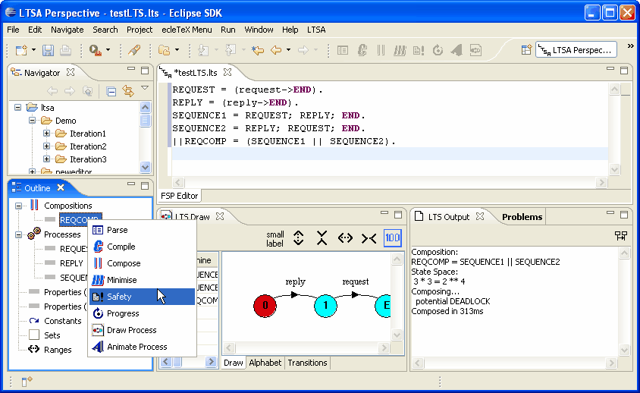
LTSA Examples
Software Architecture: Foundations, Theory, and Practice; Richard N. Taylor, Nenad Medvidovic, and Eric M. Dashofy; (C) 2008 John Wiley & Sons, Inc. Reprinted with permission.

Slide 12
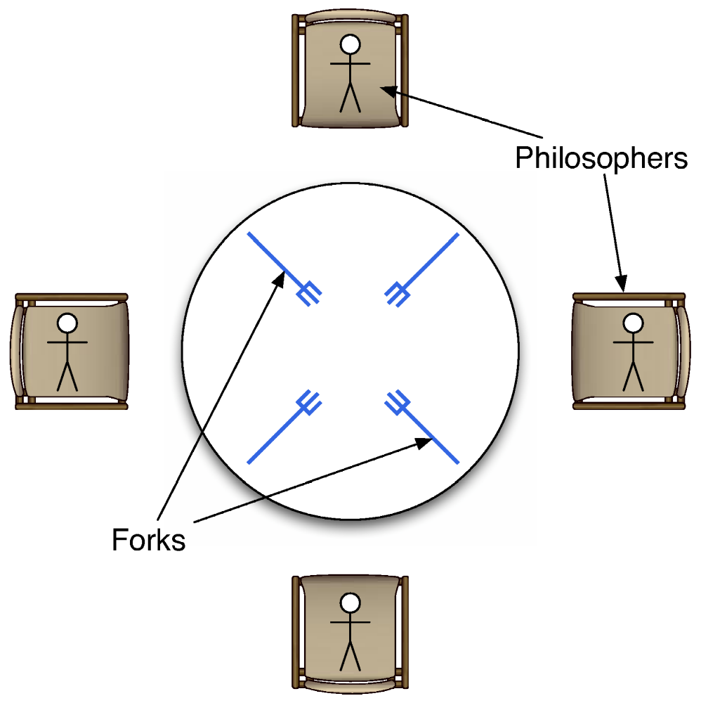
LTSA Examples
Software Architecture: Foundations, Theory, and Practice; Richard N. Taylor, Nenad Medvidovic, and Eric M. Dashofy; (C) 2008 John Wiley & Sons, Inc. Reprinted with permission.

Slide 13
LTSA: Evaluation
Scope/Purpose
  Multiple coordinated visualizations of concurrent systems’ behavior
Basic Type
  Textual, Graphical, Effect
Depiction
  Text & state machines for models, various effect viz.
Interaction
  FSP can be edited textually or graphically
Fidelity
  Graphical visualizations may elide some information
Consistency
  Limited vocabulary helps ensure consistency
Comprehensibility
  FSP has some learning curve; domain-specific effect visualizations are innovative
Dynamism
  Animation on state-transition diagrams and domain-specific visualizations
View coordination
  Views are coordinated automatically
Aesthetics
  State transition diagrams are traditional; domain-specific visualizations can enhance aesthetics
Extensibility
  New domain-specific effect visualizations as plug-ins

Slide 14
xADL Visualizations
Coordinated set of textual, graphical, and effect visualizations for an extensible ADL
Advantages
  Provides an example of how to construct a wide variety of (often) coordinated or interrelated visualizations
  Lets users move fluidly from one visualization to another
  Guidance available for extending visualizations or adding new ones
Disadvantages
  Some learning curve to extend graphical editors
  Adding or extending visualizations has to be done carefully so they play well with existing ones

Slide 15
xADL Visualization Examples
<types:component xsi:type="types:Component"
types:id="myComp">
<types:description xsi:type="instance:Description">
MyComponent
</types:description>
<types:interface xsi:type="types:Interface"
types:id="iface1">
<types:description xsi:type="instance:Description">
Interface1
</types:description>
<types:direction xsi:type="instance:Direction">
inout
</types:direction>
</types:interface>
</types:component>
Software Architecture: Foundations, Theory, and Practice; Richard N. Taylor, Nenad Medvidovic, and Eric M. Dashofy; (C) 2008 John Wiley & Sons, Inc. Reprinted with permission.

Slide 16
xADL Visualization Examples
<types:component xsi:type="types:Component"
types:id="myComp">
<types:description xsi:type="instance:Description">
MyComponent
</types:description>
<types:interface xsi:type="types:Interface"
types:id="iface1">
<types:description xsi:type="instance:Description">
Interface1
</types:description>
<types:direction xsi:type="instance:Direction">
inout
</types:direction>
</types:interface>
</types:component>
component{
id = "myComp";
description = "MyComponent";
interface{
id = "iface1";
description = "Interface1";
direction = "inout";
}
}
Software Architecture: Foundations, Theory, and Practice; Richard N. Taylor, Nenad Medvidovic, and Eric M. Dashofy; (C) 2008 John Wiley & Sons, Inc. Reprinted with permission.

Slide 17
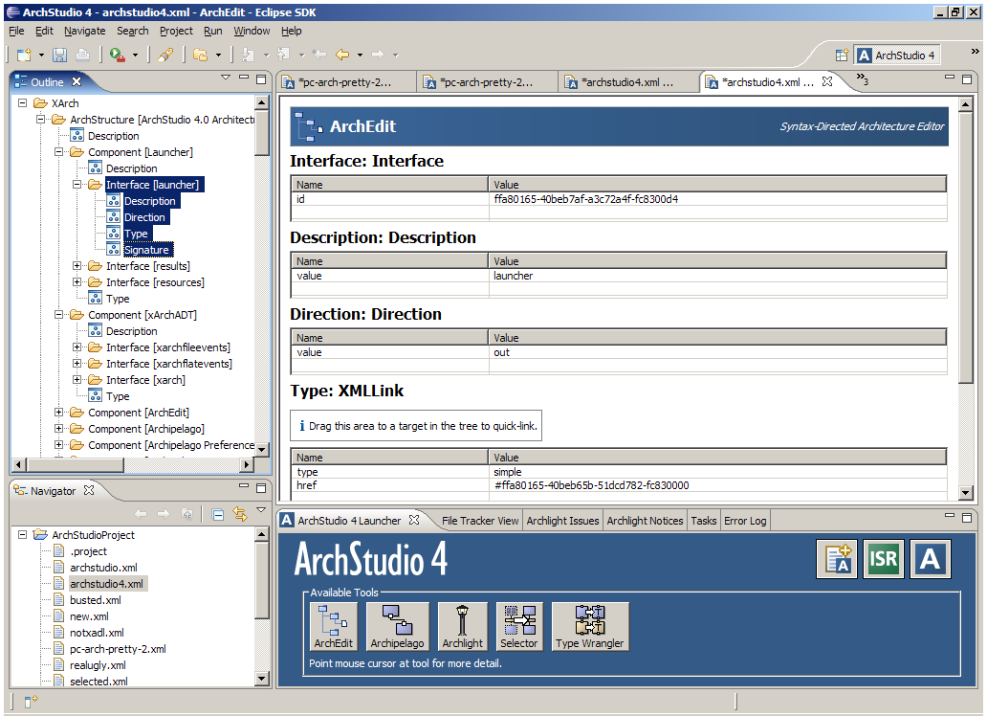
xADL Visualization Examples
<types:component xsi:type="types:Component"
types:id="myComp">
<types:description xsi:type="instance:Description">
MyComponent
</types:description>
<types:interface xsi:type="types:Interface"
types:id="iface1">
<types:description xsi:type="instance:Description">
Interface1
</types:description>
<types:direction xsi:type="instance:Direction">
inout
</types:direction>
</types:interface>
</types:component>
component{
id = "myComp";
description = "MyComponent";
interface{
id = "iface1";
description = "Interface1";
direction = "inout";
}
}
Software Architecture: Foundations, Theory, and Practice; Richard N. Taylor, Nenad Medvidovic, and Eric M. Dashofy; (C) 2008 John Wiley & Sons, Inc. Reprinted with permission.

Slide 18
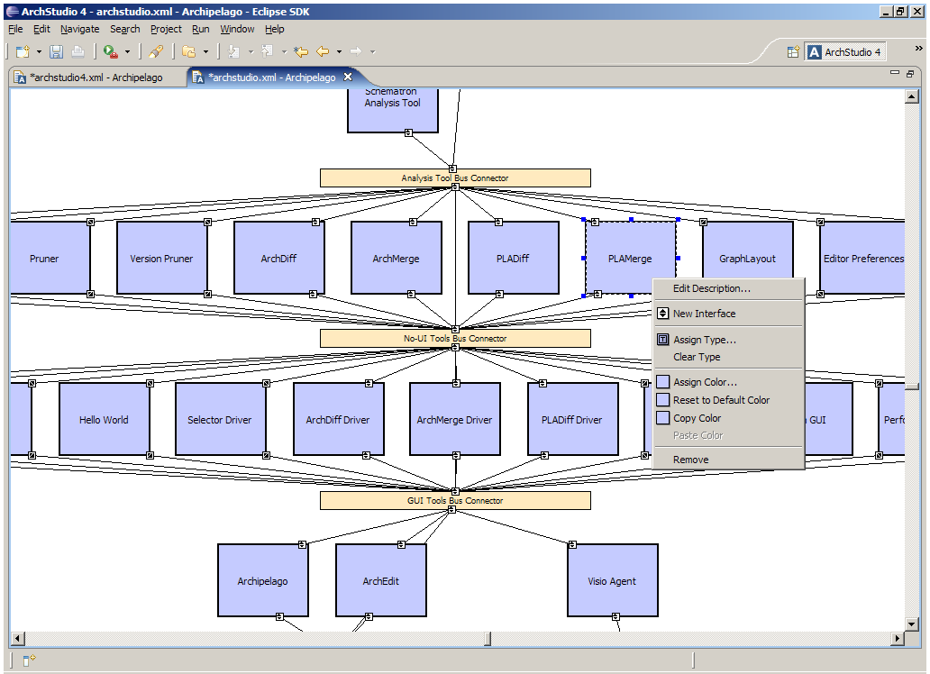
xADL Visualization Examples
<types:component xsi:type="types:Component"
types:id="myComp">
<types:description xsi:type="instance:Description">
MyComponent
</types:description>
<types:interface xsi:type="types:Interface"
types:id="iface1">
<types:description xsi:type="instance:Description">
Interface1
</types:description>
<types:direction xsi:type="instance:Direction">
inout
</types:direction>
</types:interface>
</types:component>
component{
id = "myComp";
description = "MyComponent";
interface{
id = "iface1";
description = "Interface1";
direction = "inout";
}
}
Software Architecture: Foundations, Theory, and Practice; Richard N. Taylor, Nenad Medvidovic, and Eric M. Dashofy; (C) 2008 John Wiley & Sons, Inc. Reprinted with permission.

Slide 19
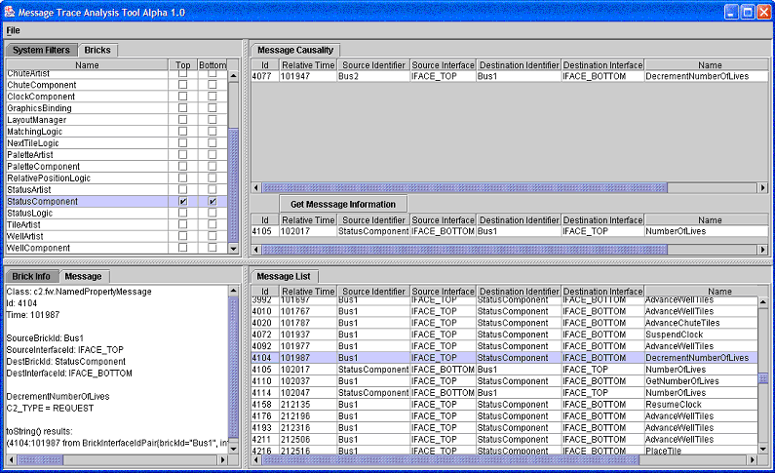
xADL Visualization Examples
<types:component xsi:type="types:Component"
types:id="myComp">
<types:description xsi:type="instance:Description">
MyComponent
</types:description>
<types:interface xsi:type="types:Interface"
types:id="iface1">
<types:description xsi:type="instance:Description">
Interface1
</types:description>
<types:direction xsi:type="instance:Direction">
inout
</types:direction>
</types:interface>
</types:component>
component{
id = "myComp";
description = "MyComponent";
interface{
id = "iface1";
description = "Interface1";
direction = "inout";
}
}
Software Architecture: Foundations, Theory, and Practice; Richard N. Taylor, Nenad Medvidovic, and Eric M. Dashofy; (C) 2008 John Wiley & Sons, Inc. Reprinted with permission.

Slide 20
xADL Visualizations: Evaluation
Scope/Purpose
  Multiple coordinated visualizations of xADL models
Basic Type
  Textual, Graphical, Effect
Depiction
  XML, abbreviated XML, symbol graphs, hybrid effect (MTAT)
Interaction
  Visualizations emulate various editing paradigms
Fidelity
  Textual & ArchEdit complete; graphical leave detail out
Consistency
  Effort to follow conventions
Comprehensibility
  Varies; some easier than others
Dynamism
  Animation on state-transition diagrams and domain-specific visualizations
View coordination
  Many views coordinated ‘live,’ MTAT leverages some animation
Aesthetics
  Varies; Archipelago promotes aesthetic improvements by allowing fine customization
Extensibility
  Many extensibility mechanisms at different levels

Slide 21
Objectives
Concepts
  What is visualization?
  Differences between modeling and visualization
  What kinds of visualizations do we use?
  Visualizations and views
  How can we characterize and evaluate visualizations?
Examples
  Concrete examples of a diverse array of visualizations
Constructing visualizations
  Guidelines for constructing new visualizations
  Pitfalls to avoid when constructing new visualizations
  Coordinating visualizations

Slide 22
Constructing New Visualizations
Developing a new visualization can be expensive both in initial development and maintenance
Must answer many questions in advance
  Can I achieve my goals by extending an existing visualization?
  Can I translate into another notation and use a visualization already available there?
  How will my visualization augment the existing set of visualizations for this notation?
  How will my visualization coordinate with other visualizations?
  (Plus all the evaluation categories we’ve been exploring)

Slide 23
New Visualizations: Guidelines
Borrow elements from similar visualizations
  Leverages existing stakeholder knowledge
  Improves comprehensibility
Be consistent among visualizations
  Don’t conflict with existing visualizations without a good reason (e.g., developing a domain-specific visualization where the concepts and metaphors are completely different)
Give meaning to each visual aspect of elements
  Parsimony is more important than aesthetics
  Corollary: avoid having non-explicit meaning encoded in visualizations

Slide 24
New Visualizations: Guidelines (cont’d)
Document the meaning of visualizations
  Visualizations are rarely self-explanatory
  Focus on mapping between model and visualization
Balance traditional and innovative interfaces
  Stakeholders bring a lot of interaction experience to the table
  But just because a mechanism is popular doesn’t mean it’s ideal

Slide 25
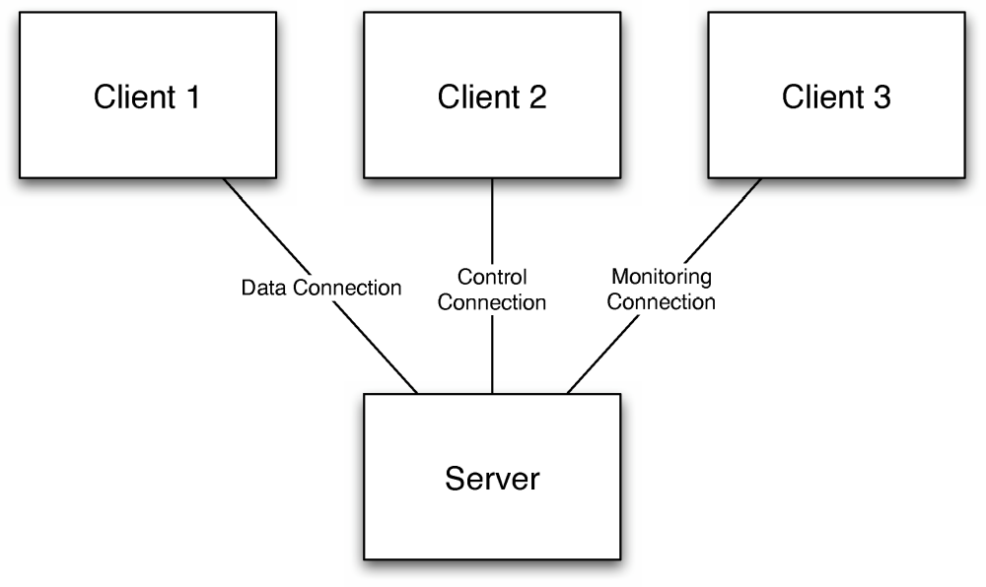
New Visualizations: Anti-Guidelines
Same Symbol, Different Meaning
Software Architecture: Foundations, Theory, and Practice; Richard N. Taylor, Nenad Medvidovic, and Eric M. Dashofy; (C) 2008 John Wiley & Sons, Inc. Reprinted with permission.

Slide 26
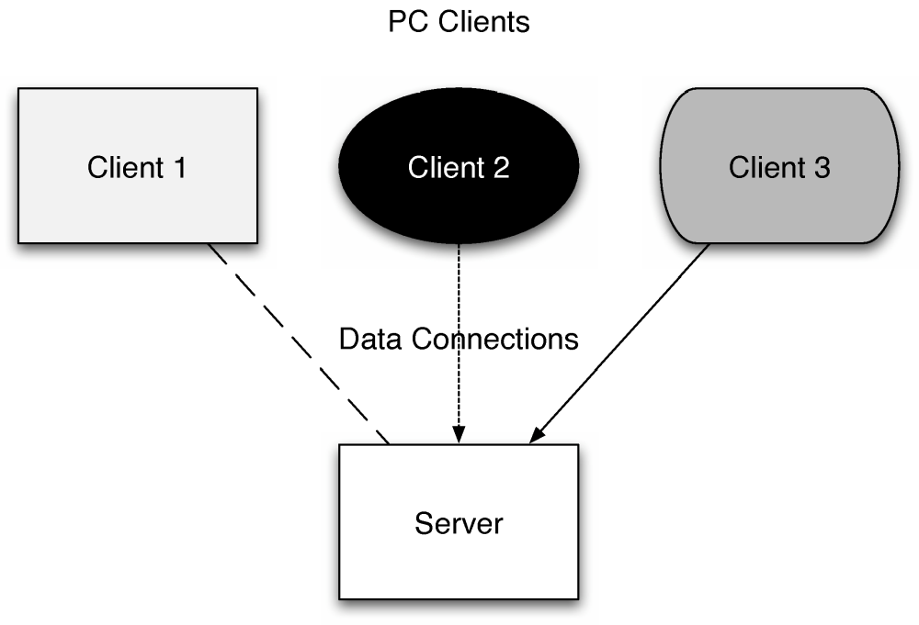
New Visualizations: Anti-Guidelines (cont’d)
Differences without meaning
Software Architecture: Foundations, Theory, and Practice; Richard N. Taylor, Nenad Medvidovic, and Eric M. Dashofy; (C) 2008 John Wiley & Sons, Inc. Reprinted with permission.

Slide 27
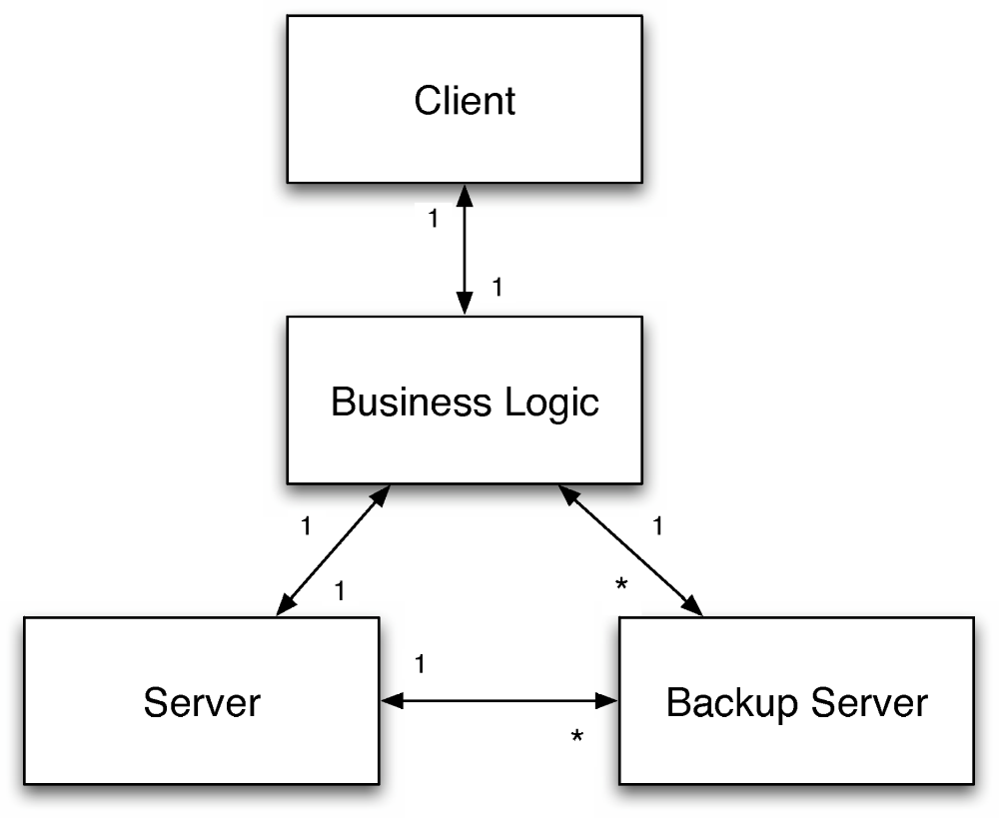
New Visualizations: Anti-Guidelines (cont’d)
Decorations without meaning
Software Architecture: Foundations, Theory, and Practice; Richard N. Taylor, Nenad Medvidovic, and Eric M. Dashofy; (C) 2008 John Wiley & Sons, Inc. Reprinted with permission.

Slide 28
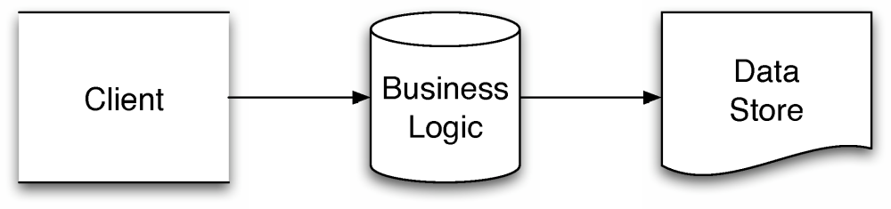
New Visualizations: Anti-Guidelines (cont’d)
Borrowed symbol, different meaning
Software Architecture: Foundations, Theory, and Practice; Richard N. Taylor, Nenad Medvidovic, and Eric M. Dashofy; (C) 2008 John Wiley & Sons, Inc. Reprinted with permission.

Slide 29
Coordinating Multiple Visualizations
How do we keep multiple simultaneous visualizations of the same (part of the) architectural model consistent with each other and the model?
  This is NOT the same as maintaining architectural consistency
  If something is wrong with the model, this error would be reflected in the visualizations
Can be made much easier by making simplifying assumptions, e.g.:
  Only one visualization may operate at a time
  Only one tool can operate on the model at a time
But what if we can’t simplify like this?

Slide 30
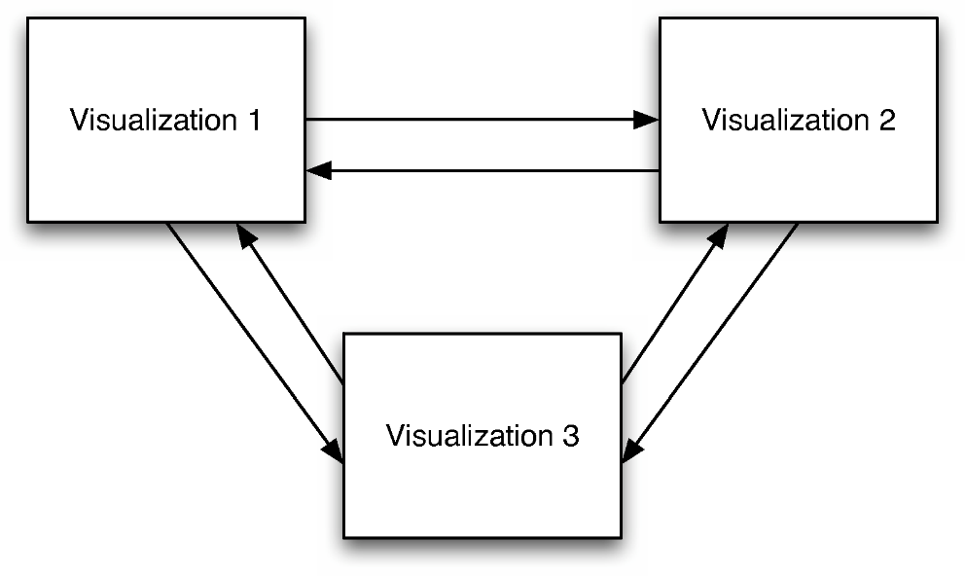
Strategy: Peer-to-Peer Coordination
Each visualization communicates with each other visualization for updates
  Has scaling problems
  Works best for visualizations known a priori
Software Architecture: Foundations, Theory, and Practice; Richard N. Taylor, Nenad Medvidovic, and Eric M. Dashofy; (C) 2008 John Wiley & Sons, Inc. Reprinted with permission.

Slide 31
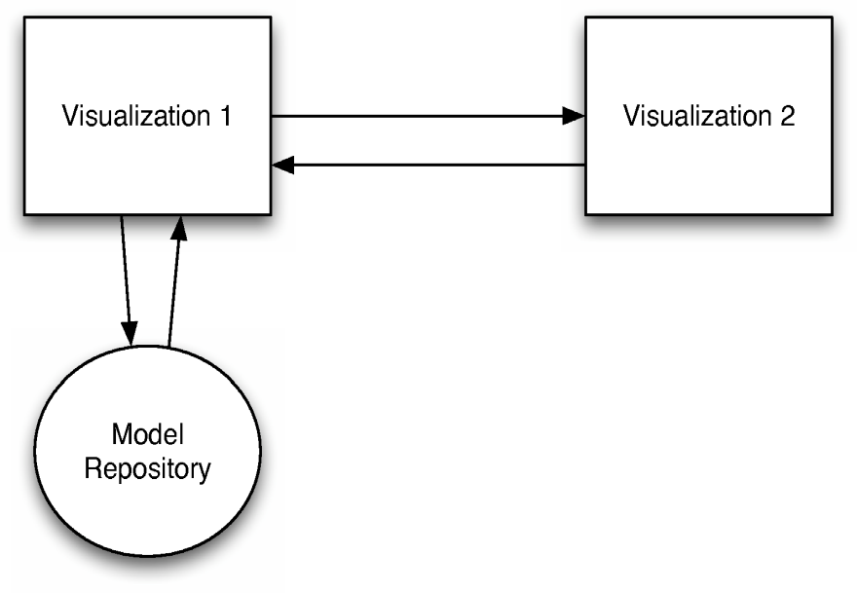
Strategy: Master-Slave
One visualization is the master and others coordinate through it
Works best when visualizations are subordinate
  E.g., a “thumbnail” or “overview” next to a main, zoomed-in visualization
Software Architecture: Foundations, Theory, and Practice; Richard N. Taylor, Nenad Medvidovic, and Eric M. Dashofy; (C) 2008 John Wiley & Sons, Inc. Reprinted with permission.

Slide 32
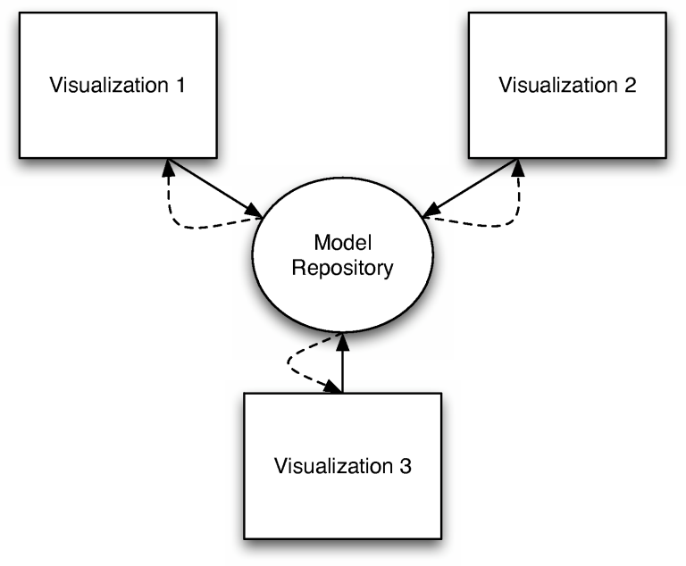
Strategy: Pull-based
Visualizations repeatedly poll a model repository for changes
Potential consistency/staleness problems
May be necessary if model repository is entirely passive
May save computing power
Software Architecture: Foundations, Theory, and Practice; Richard N. Taylor, Nenad Medvidovic, and Eric M. Dashofy; (C) 2008 John Wiley & Sons, Inc. Reprinted with permission.

Slide 33
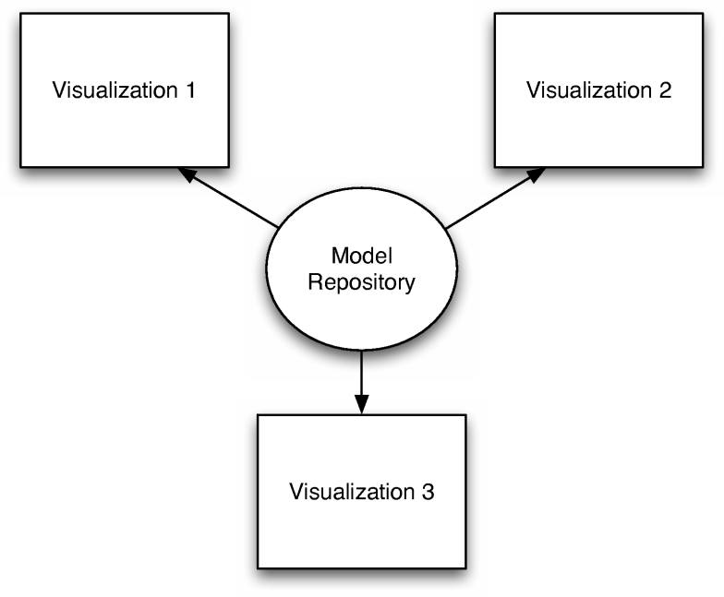
Strategy: Push-based
Visualizations actively notified and update themselves whenever model changes for any reason
Best for multiple simultaneous visualizations
Hard to debug, must avoid infinite loops and subtle concurrency conditions
Software Architecture: Foundations, Theory, and Practice; Richard N. Taylor, Nenad Medvidovic, and Eric M. Dashofy; (C) 2008 John Wiley & Sons, Inc. Reprinted with permission.

Slide 34
Caveats
Like the modeling lectures, this optimized for breadth rather than depth
  You are encouraged to explore these in depth, as well as visualizations you encounter in your own experiences
Although we can attempt to conceptually separate modeling notations and visualizations, they are never truly distinct
  Each influences the other in direct and indirect ways

